Slide 1
Least Square Regression
MATH 4341 : Linear Algebra
Aashnan Rahman
Junior Lecturer
Department of Computer Science and Engineering (CSE)
Islamic University of Technology

Slide 2
Recap
b
e
a
p

Slide 3
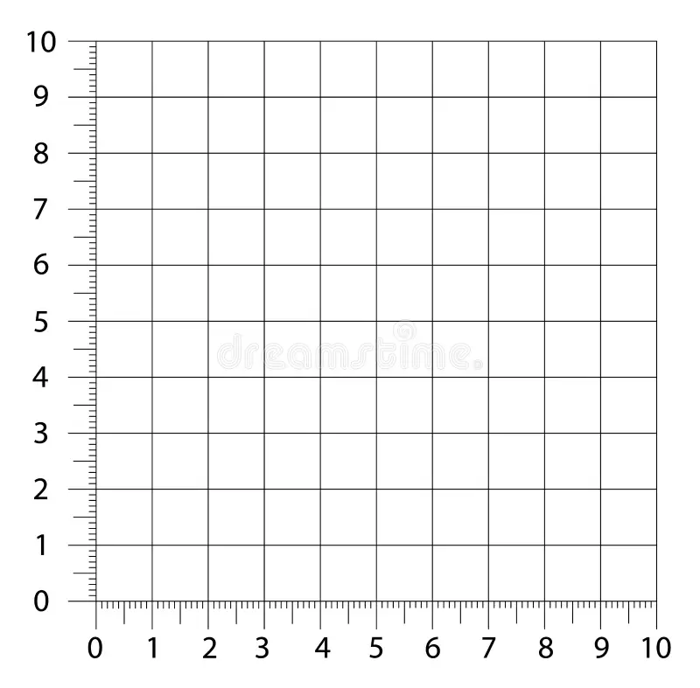
Least Square Regression (Best Fitting Line)
Area (thousand sq. ft) | Rent (k$)
1 | 3
1.5 | 4.5
2 | 6

Slide 4
Least Square Regression (Best Fitting Line)
?
Area (thousand sq. ft) | Rent (k$)
2 | 3
4 | 6
6 | 7

Slide 5
Least Square Regression
Find out the best Fitting Line
Minimize Overall Error

Slide 6
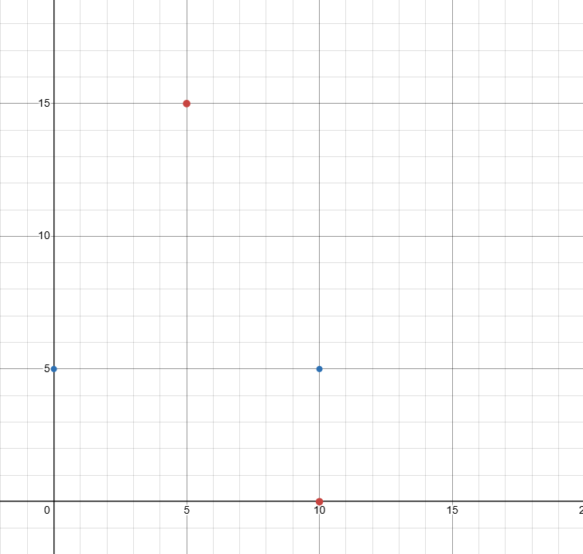
Least Square Regression
e₄
e₃
e₁
e₂

Slide 7
Least Square Regression
x | y | y = mx+c
0 | 5 | 0.m + c = 5
10 | 5 | 10.m + c = 5
10 | 0 | 10.m + c = 0
5 | 15 | 5.m + c = 15

Slide 8
Least Square Regression
e₄
e₁
e₃
e₂

Slide 9
Least Square Regression
x | y | mx+c - y | y – x | y – (– 5/11)x + (100/11)
0 | 5 | 5 – (0.m + c) | 5 | – 45/11
10 | 5 | 5 – (10.m + c) | – 5 | 5/11
10 | 0 | 0 – (10.m + c) | –10 | – 50/11
5 | 15 | 15 – (5.m + c ) | 10 | 90/11
Sum of Squared Errors | 250 | 104.5455

Slide 10
Least Square Regression
Ways to minimize Errors
Geometric
2. (Linear) Algebra [Projection]
3. Calculus

Slide 11

Minimizing Error using Calculus

Slide 12
Minimizing Error using Calculus
……….(i)
……….(ii)

Slide 13
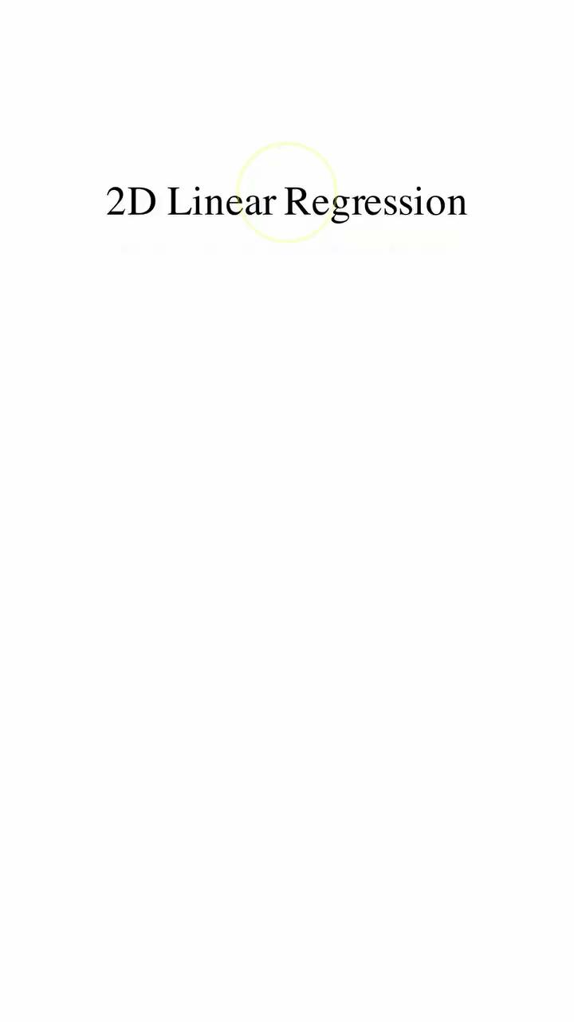

Slide 14
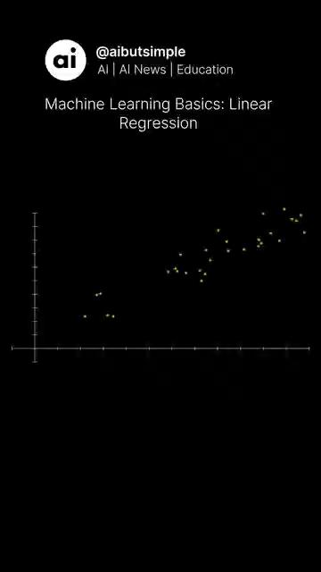

Slide 15
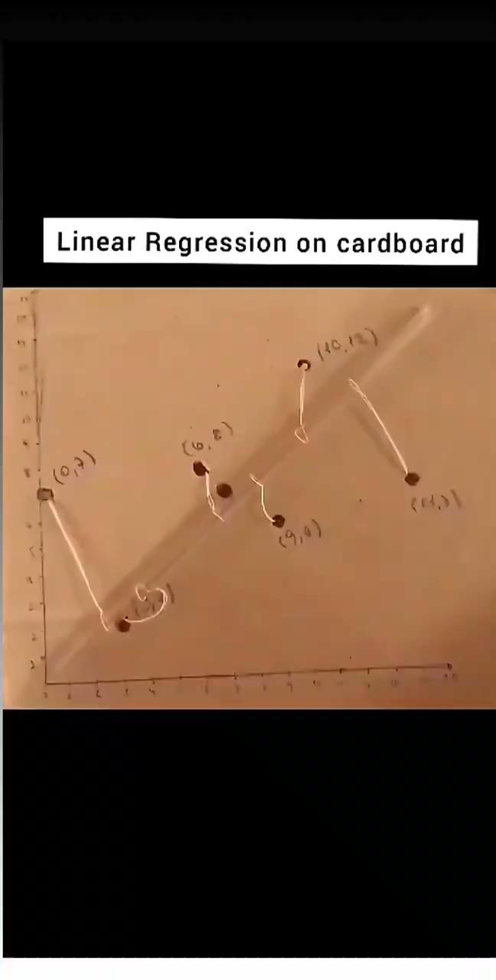

Slide 16
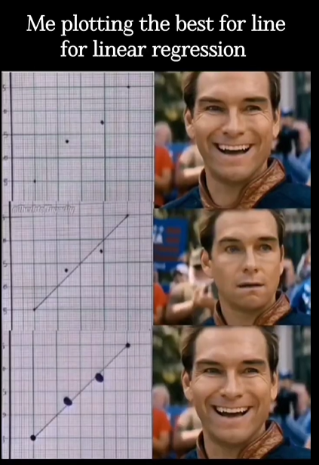

Slide 17
If A has independent columns, A^{T}A is invertible.

Slide 18
References
Tools
Gilbert Strang (L16)
Math is Fun

Slide 19

¡THANKS!

